Slide 1


WHICH SUBREDDIT DOES THE POST BELONG?
YALIM DEMIRKESEN

Slide 2
CONTENT
Background Information about the Selected TV Shows
Problem Definition
Scraping
Preparing the Model
Model Evaluation
Ways to Improve

Slide 3


Slide 4


Slide 5
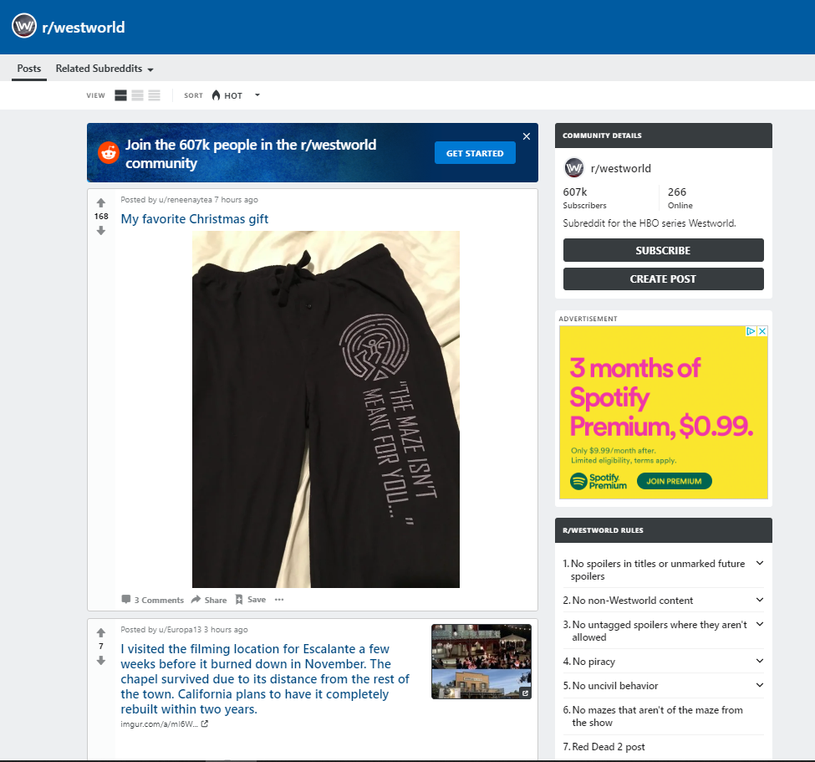
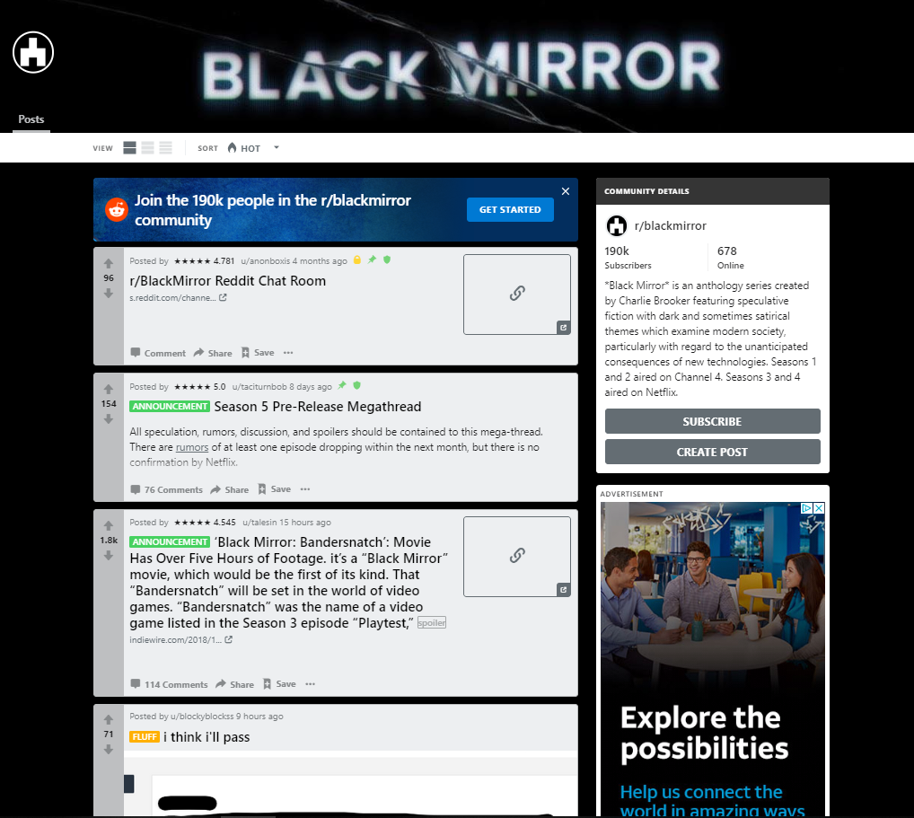

Slide 6
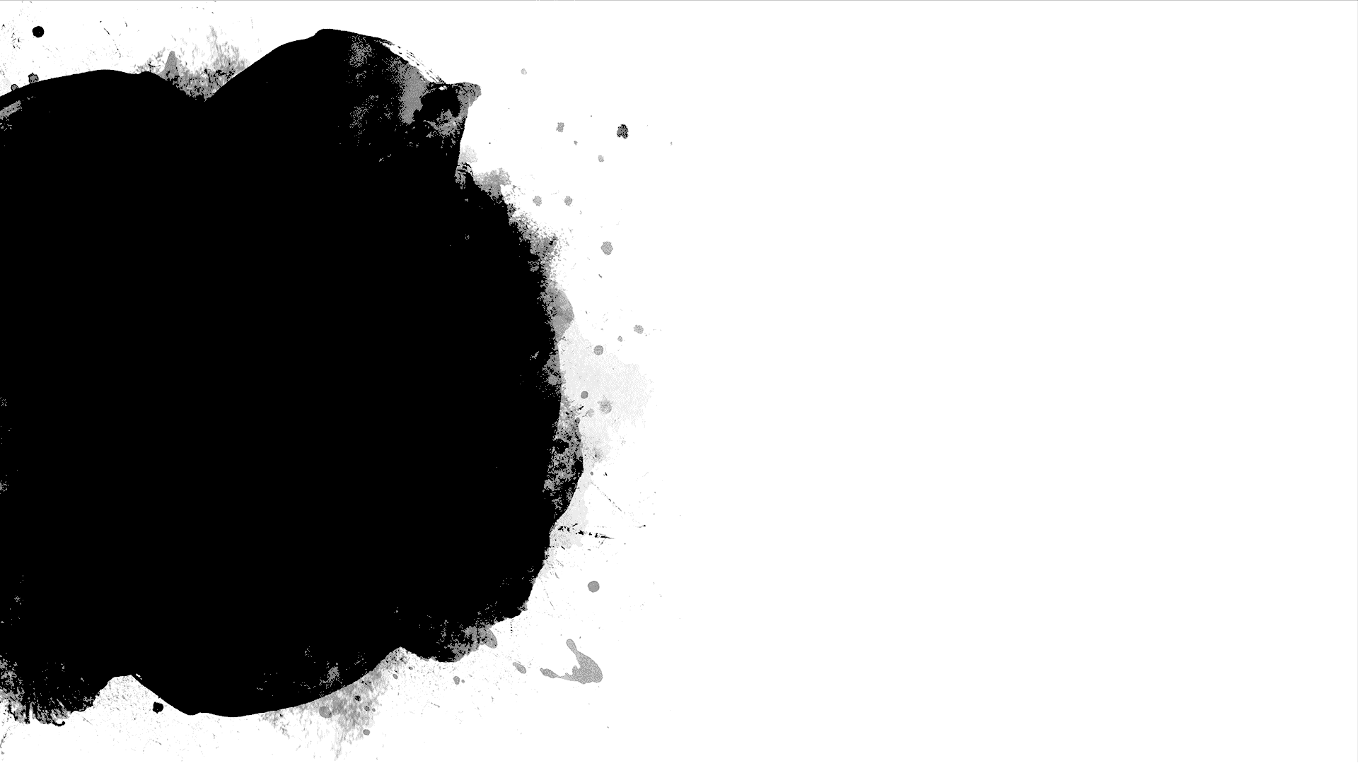
SCRAPING
Time Created
ID of the post
Contains a Video?
Number of Comments
Score for the Post
Post Body
Includes Spoiler?
Subreddit
Title of the Post

Slide 7
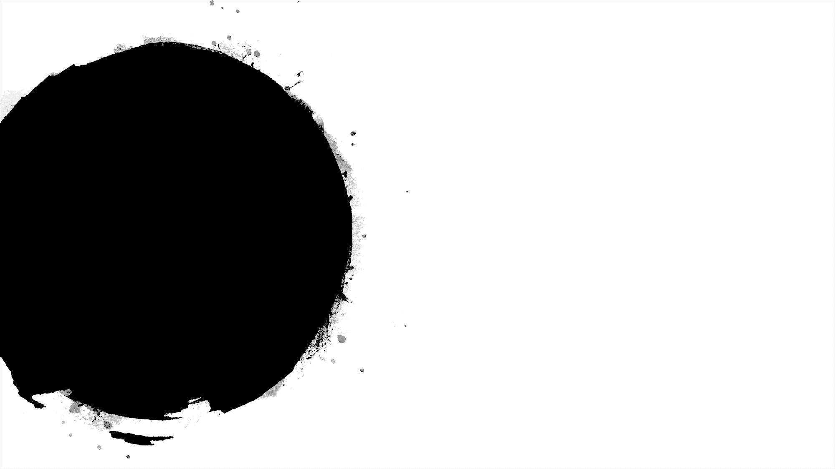

PREPARING THE MODEL
Time Created
ID of the post
Post Body
Subreddit
Title of the Post

Slide 8
MODEL EVALUATION
 | Logistic Regression | Random Forest
Title | 0.90 | 0.86
Posts | 0.93 | 0.87

Slide 9
WAYS TO IMPROVE
Other social media platforms
Suffering from overfitting
Considering the trends

Slide 10
Thank you!

